Slide 1
User Manual
Smart Systems for Occupancy and Building Energy Control
Team: Dalaidis Hidalgo, Maria E. Presa Reyes Mentor: Ali Mostafavi, Leonardo Bobadilla

Slide 2
Overview
You can configure the application Smart System for Occupancy and Building Energy Control in order in to learn how to use the energy in the appropriate manner.
This manual delivers an overview of the sample application. Beginning with the following information:
View Zones Data
View Lighting Data
View Plug Load Data
View Temperature Data
View Occupancy Behavior

Slide 3
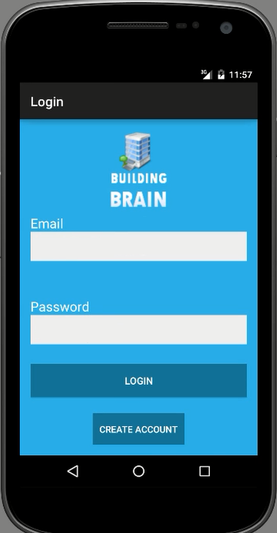
Step 1
The user is required to enter the username and password then click on the LOGIN button.

Slide 4
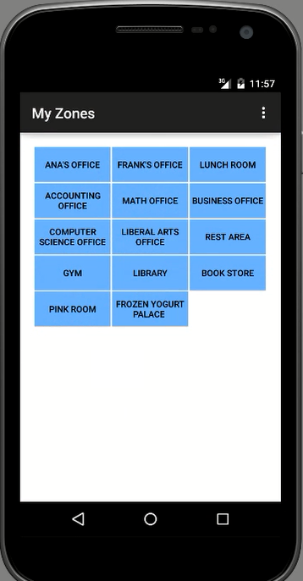
Step 2
The user is required to SELECT A ZONE where he/she can see the different options for energy performance

Slide 5
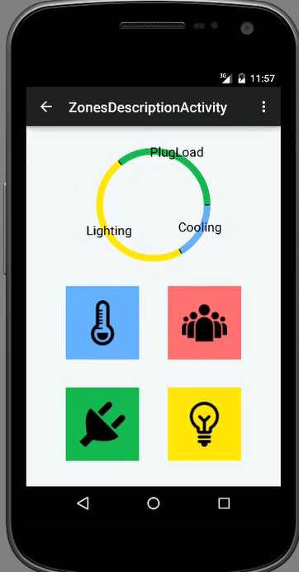
Step 3
The user is required to make a selection in ZONES DESCRIPTION to see Temperature, Occupancy, Plug Load, and/or Artificial Lighting.

Slide 6
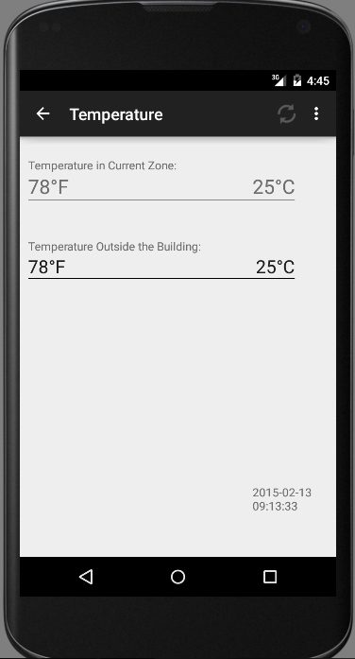
Step 4
The user can see the TEMPERATURE of one specific zone that had a previous selection and he/she is enable to make REFRESH in order to be able to always update the information.

Slide 7
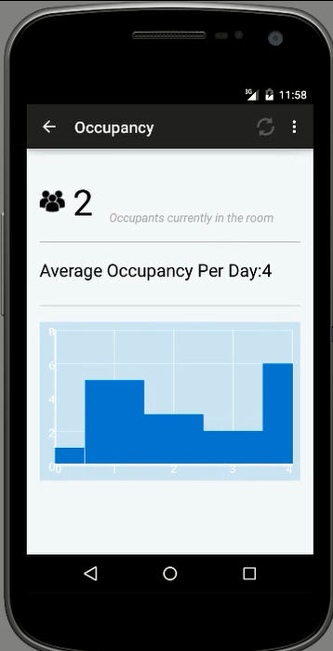
Step 5
The user can see the OCCUPANCY of one specific zone that had a previous selection and he/she is enable to make REFRESH in order to have always update it is information.

Slide 8
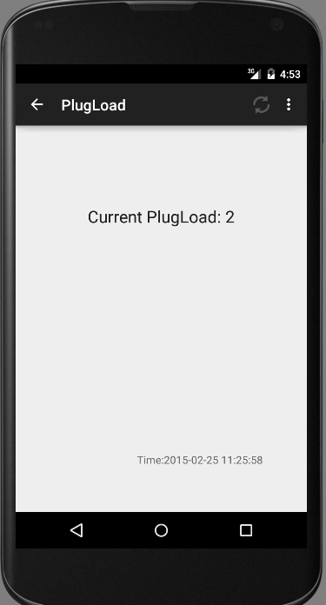
Step 6
The user can see the PLUG LOAD of one specific zone that had a previous selection and he/she is enable to make REFRESH in order to be able to always update the information.

Slide 9
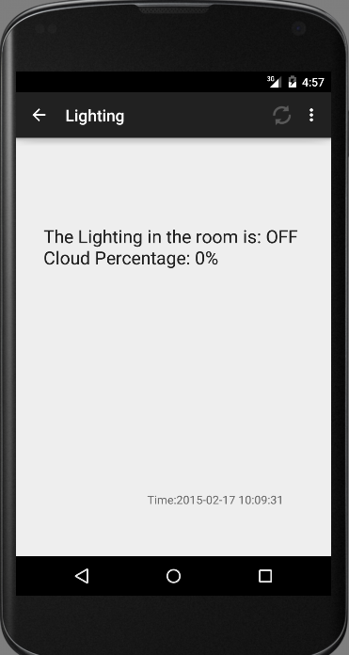
Step 7
The user can see the LIGHTING of one specific zone that had a previous selection and he/she is enable to make REFRESH in order to be able to always update the information.

Slide 10
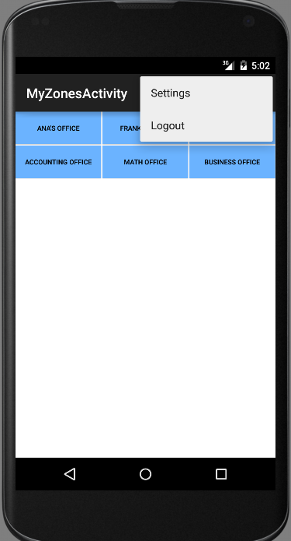
Step 8
The user is required open the popup menu in the Action Bar in order to click in the LOGOUT button

